Slide 1

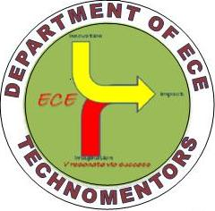

RajaRajeswari College of Engineering Affiliated to VTU, Belagavi, Apporoved by AICTE, New Delhi& Govt of Karnataka. Internationally Accredited by HLACT, Texas,USA, Accredited by NBA(CSE,ECE,EEE,MECH),Accredited by NAAC Department of Electronics & Communication Engg.. NBA ACCREDITED Dept.
A Technical Seminar
On
“IOT FOR SMART HEALTHCARE:
TECHNOLOGIES, CHALLENGES, AND OPPORTUNITIES”
By
Ayush Rathore
1RR14EC015
Under the Guidance of
Mrs. Jyothi AP
Assistant professor, ECE

Slide 2
CONTENTS:
Abstract
Introduction
Literature survey
Proposed methodology
Explanation
Applications
Advantages & Disadvantages
Conclusion
Reference

Slide 3
ABSTRACT:
Internet of things(IoT) technology has attracted much attraction in recent years.
It has potential to release strain on healthcare systems caused by an aging population and a rise in chronic illness.
Standardization is a key issue limiting progress in this area.
This paper proposes a standard model for application in future IoT healthcare systems.
Challenges that healthcare IoT faces including security, privacy, wearability, and low-power operation are presented.

Slide 4
INTRODUCTION:
IoT can be described as a network of devices interacting with each other via machine to machine (M2M) communications.
Healthcare is an essential part of life. Unfortunately, the steadily aging population and the related rise in chronic illness is placing signiﬁcant strain on modern healthcare systems.
The Internet of Things (IoT) has been widely identiﬁed as a potential solution to alleviate the pressures on healthcare systems, and has thus been the focus of much recent research.
A considerable amount research looks at monitoring patients with speciﬁc conditions, such as diabetes or Parkinson’s disease.

Slide 5
LITERATURE SURVEY:
N.Zhuetal.,‘‘Bridging health and the Internet of Things: The SPHERE project,’’ IEEE Intell. Syst., vol. 30, no. 4, pp. 39–46, Jul./Aug. 2015:
There's a widely known need to revise current forms of healthcare provision. Of particular interest are sensing systems in the home, which have been central to several studies. This article presents an overview of this rapidly growing body of work, as well as the implications for machine learning.
Y. J. Fan, Y. H. Yin, L. D. Xu, Y. Zeng, and F. Wu, ‘‘IoT-based smart rehabilitation system,’’ IEEE Trans. Ind. Informat., vol. 10, no. 2, pp. 1568–1577, May 2014:
Internet of Things (IoT) makes all objects become interconnected and smart, which has been recognized as the next technological revolution. As its typical case, IoT-based smart rehabilitation systems are becoming a better way to mitigate problems associated with aging populations and shortage of health professionals.

Slide 6
S. Sarkar and S. Misra, ‘‘From micro to nano: The evolution of wireless sensor-based health care,’’ IEEE Pulse, vol. 7, no. 1, pp. 21–25, Jan./Feb. 2016:
Health care, among various other fields, has benefited vastly from this technological development. The concept of using sensors for health care purposes originated in the late 1980s when sensors were developed to measure certain physiological parameters associated with the human body.
Sayed and G.Thandavarayan,‘‘Congestion detection and propagation in urban areas using histogram models,’’ IEEE Internet Things J., to be published:
Rapid growth of urbanization makes the roadways exacerbate many problems like traffic congestion, road accidents and passenger discomfort. Many actions have been taken globally to solve or reduce this impact but still the congestion problem seems to be persistent globally. In this paper, we propose a new histogram-based model for congestion detection. We subsequently extended our model with the base platform concept and use Intelligent Transportation System (ITS) technologies to provide a novel rerouting strategy.

Slide 7
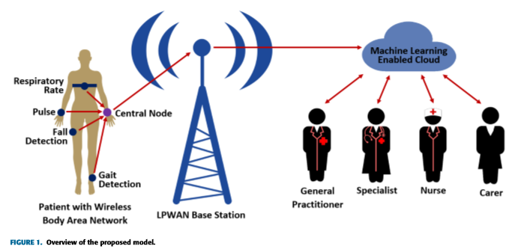
PROPOSED METHODOLOGY:

Slide 8
EXPLAINATION:
For sensors to communicate with the central node, a short range communications method is required.
Data obtained by the central node is not useful unless something can be done with it. This data should be forwarded to a database where relevant parties (such as caretakers or doctors) can securely access it.
Here strong security is important to ensure that sensitive patient data remains private and cannot be altered or imitated.
High-quality error correcting capabilities and signiﬁcant robustness against interference are essential, as these ensure that the message sent is the same as the message received.
Medical information obtained from patients must be stored securely for continued use, , cloud storage is the most viable method for storing data.
Following our proposed model, a rehabilitation system for knee injuries could be developed by using wearable accelerometer sensors on either side of the knee, to allow for the position and angle of the knee to be calculated.
This information could then be provided to responding paramedics, ensuring that patients receive the most appropriate care for their condition, and rapidly.

Slide 9
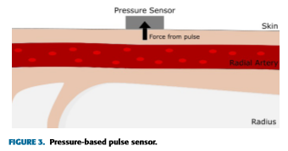
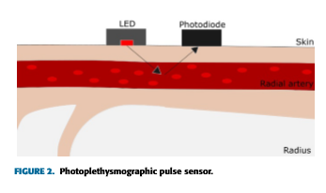
SENSORS:
PULSE SENSOR:
The most commonly read vital sign, pulse can be used to detect a wide range of emergency conditions, such as cardiac arrest, pulmonary embolisms, and vasovagal syncope. Pulse sensors have been widely researched, both for medical purposes and for ﬁtness tracking.
Pulse can be read from the chest, wrist, earlobe, ﬁngertip, and more. Earlobe and ﬁngertip readings provide high accuracy, but are not highly wearable.

Slide 10
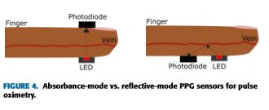
PULSE OXIMETRY SENSORS:
Pulse oximetry measures the level of oxygen in the blood. Like blood pressure, blood oxygen level is not a vital sign, but does serve as an indicator of respiratory function and can aid in diagnostics of conditions such as hypoxia (low oxygen reaching the body’s tissues). As such, pulse oximetry is a valuable addition to a general health monitoring system.

Slide 11
APPLICATIONS:
Remote health monitoring could be used to monitor non-critical patients at home rather than in hospital, reducing strain on hospital resources such as doctors and beds.
It could be used to provide better access to healthcare for those living in rural areas.

Slide 12
ADVANTAGES:
Decreased Costs–When healthcare providers take advantage of the connectivity of the healthcare solutions, patient monitoring can be done on a real time basis, thus significantly cutting down on unnecessary visits by doctors.
Improved Disease Management – When patients are monitored on a continuous basis and health care providers are able to access real time data, diseases are treated before they get out of hand.
Reduced Errors – Accurate collection of data, automated workflows combined with data driven decisions are an excellent way of cutting down on waste, reducing system costs and most importantly minimizing on errors.

Slide 13
DISADVANTAGES:
The most signiﬁcant disadvantages include the security risk that comes with having large amounts of sensitive data stored in a single database.
Compatibility is major issue, that there is no standard for tagging and monitoring with sensors.
Resources still reside locally comparing with using cloud.

Slide 14
CONCLUSION:
In this work, a unique model for future IoT-based healthcare systems, which can be applied to both general systems and systems that monitor speciﬁc conditions is proposed.
Based on our analysis of state-of-the-art technologies in the ﬁelds of wearable sensors, communications standards, and cloud technology, we identiﬁed several signiﬁcant areas for future research.
Machine learning and the development of a secure yet lightweight encryption scheme for cloud storage were the two areas that provide the most opportunity for researchers seeking to make signiﬁcant improvements in the ﬁeld of IoT-based healthcare.

Slide 15
REFERENCES:
E. Perrier, Positive Disruption: Healthcare, Ageing and Participation in the Age of Technology. Sydney, NSW, Australia: The McKell Institute, 2015.
P. Gope and T. Hwang, ‘‘BSN-care: A secure IoT-based modern healthcare system using body sensor network,’’ IEEE Sensors J., vol. 16, no. 5, pp. 1368–1376, Mar. 2016.
N. Zhuetal. Bridging e-health and the Internet of Things : The SPHERE project,’’ IEEE Intell. Syst., vol. 30, no. 4, pp. 39–46, Jul./Aug. 2015.
Y. J. Fan, Y. H. Yin, L. D. Xu, Y. Zeng, and F. Wu, ‘‘IoT-based smart rehabilitation system,’’ IEEE Trans. Ind. Informat., vol. 10, no. 2, pp. 1568–1577, May 2014.
S. M. R. Islam, D. Kwak, H. Kabir, M. Hossain, and K.-S. Kwak, ‘‘The Internet of Things for health care: A comprehensive survey,’’ IEEE Access, vol. 3, pp. 678–708, 2015.

Slide 16
THANK YOU

